Slide 1
Network Security Essentials
Chapter 4
Fourth Edition
by William Stallings
Electronic Mail Security
Dr. Bremnavas Ismail Mohideen
Notes:
Lecture slides prepared for “Network Security Essentials”, 5/e, by William Stallings, Chapter 8 – “Electronic Mail Security”.

Slide 2
Key Objectives of Chapter – 4
To learn about Electronic mail security
To understand PGP and its operation
To learn about S/MIME and its functionalities
Notes:
Opening quote.

Slide 3
There are two main schemes which are especially designed to provide confidentiality and authentication for electronic mail systems.
PGP : Pretty Good Privacy
S/MIME : Secure/Multipurpose Internet Mail Extension

Slide 4
Pretty Good Privacy (PGP)
Provides a confidentiality and authentication service that can be used for electronic mail and file storage applications
Developed by Phil Zimmermann
  Selected the best available cryptographic algorithms as building blocks
  Integrated these algorithms into a general-purpose application
  Made the package and its documentation, including the source code, freely available via the Internet, bulletin boards, and commercial networks
  Entered into an agreement with a company to provide a fully compatible, low-cost commercial version of PGP
Notes:
PGP is a remarkable phenomenon. Largely the effort of a single person, Phil
Zimmermann, PGP provides a confidentiality and authentication service that can
be used for electronic mail and file storage applications. In essence, Zimmermann
has done the following:
1. Selected the best available cryptographic algorithms as building blocks.
2. Integrated these algorithms into a general-purpose application that is independent
of operating system and processor and that is based on a small set of
easy-to-use commands.
3. Made the package and its documentation, including the source code, freely
available via the Internet, bulletin boards, and commercial networks such as
AOL (America On Line).
4. Entered into an agreement with a company (Viacrypt, now Network
Associates) to provide a fully compatible, low-cost commercial version of PGP.

Slide 5
PGP Growth
It is available free worldwide in versions that run on a variety of platforms
The commercial version satisfies users who want a product that comes with vendor support
It is based on algorithms that have survived extensive public review and are considered extremely secure
It has a wide range of applicability
It was not developed by, nor is it controlled by, any governmental or standards organization
Is now on an Internet standards track, however it still has an aura of an antiestablishment endeavor
Notes:
PGP has grown explosively and is now widely used. A number of reasons can
be cited for this growth.
1. It is available free worldwide in versions that run on a variety of platforms, including
Windows, UNIX, Macintosh, and many more. In addition, the commercial
version satisfies users who want a product that comes with vendor support.
2. It is based on algorithms that have survived extensive public review and are
considered extremely secure. Specifically, the package includes RSA, DSS, and
Diffie-Hellman for public-key encryption; CAST-128, IDEA, and 3DES for
symmetric encryption; and SHA-1 for hash coding.
3. It has a wide range of applicability, from corporations that wish to select and
enforce a standardized scheme for encrypting files and messages to individuals
who wish to communicate securely with others worldwide over the Internet
and other networks.
4. It was not developed by, nor is it controlled by, any governmental or standards
organization. For those with an instinctive distrust of “the establishment,” this
makes PGP attractive.
5. PGP is now on an Internet standards track (RFC 3156; MIME Security with
OpenPGP ). Nevertheless, PGP still has an aura of an antiestablishment
endeavor.

Slide 6
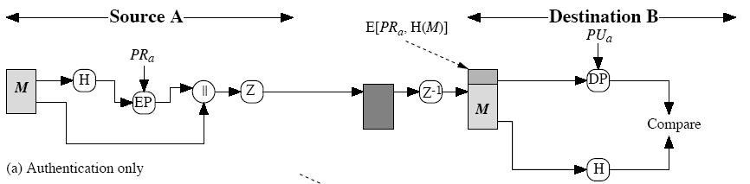
PGP Operation – Digital Signatures (Authentication only)
Classical application of public key crypto
  This figure is actually for RSA
  for DSA refer to previous lectures
Z is zip function
radix-64 conversion is done after zip at sender, before Z-1 at receiver
  may be done only for signature or for the whole message

Slide 7
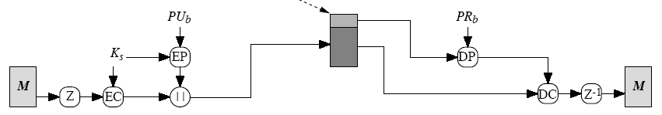
PGP Operation – Confidentiality
E[PU_{b}, K_{s}]
One-time session key, K_{s}
  generated at random
  encrypted using a public key cryptosystem, EP
    RSA or ElGamal
Message is compressed before encryption
  This is the default case

Slide 8
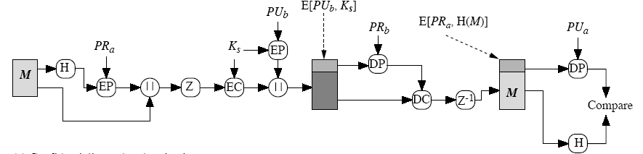
PGP Operation – Confidentiality and Authentication
uses both services on same message
  create signature and attach to message
  compress and encrypt both message & signature
  attach encrypted session key
  radix-64 conversion is for everything at the end

Slide 9
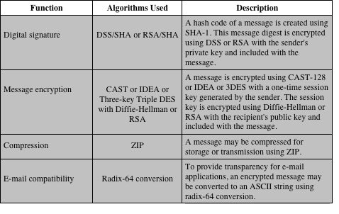
Summary of PGP Services
Notes:
The actual operation of PGP, as opposed to the management of keys, consists of
four services: authentication, confidentiality, compression, and e-mail compatibility
(Table 8.1).

Slide 10
Secure/Multipurpose Internet Mail Extension (S/MIME)
A security enhancement to the MIME Internet e-mail format standard based on technology from RSA Data Security
Defined in:
  RFCs 3370, 3850, 3851, 3852
A standard way for email encryption and signing
IETF effort (RFCs 2632, 2633 – for version 3.0; RFCs 3850, 3851 for version 3.1; 5750, 5751 for version 3.2)
Industry support
Not a standalone software, a system that is to be supported by email clients
  such as MS Outlook and Thunderbird
S/MIME handles digital signatures
  Also provides encryption
Notes:
Secure/Multipurpose Internet Mail Extension (S/MIME) is a security enhancement
to the MIME Internet e-mail format standard based on technology from RSA Data
Security. Although both PGP and S/MIME are on an IETF standards track, it appears
likely that S/MIME will emerge as the industry standard for commercial and
organizational use, while PGP will remain the choice for personal e-mail security
for many users. S/MIME is defined in a number of documents—most importantly
RFCs 3370, 3850, 3851, and 3852.
To understand S/MIME, we need first to have a general understanding of the underlying
e-mail format that it uses, namely MIME. But to understand the significance
of MIME, we need to go back to the traditional e-mail format standard, RFC 822,
which is still in common use. The most recent version of this format specification is
RFC 5322 (Internet Message Format ). Accordingly, this section first provides an introduction
to these two earlier standards and then moves on to a discussion of S/MIME.

Slide 11
Quick E-mail History
SMTP and RFC 822
  only ASCII messages (7-bit)
MIME (Multipurpose Internet Mail Extensions)
  content type
    Almost any type of information can appear in an email message
  transfer encoding
    specifies how the message body is encoded into textual form (radix64 is common)
S/MIME: Secure MIME
  new content types, like signature, encrypted data

Slide 12
Multipurpose Internet Mail Extensions (MIME)
An extension to the RFC 5322 framework that is intended to address some of the problems and limitations of the use of Simple Mail Transfer Protocol (SMTP)
  Is intended to resolve these problems in a manner that is compatible with existing RFC 5322 implementations
  The specification is provided in RFCs 2045 through 2049
Notes:
Multipurpose Internet Mail Extension (MIME) is an extension to the RFC 5322
framework that is intended to address some of the problems and limitations of the
use of Simple Mail Transfer Protocol (SMTP), defined in RFC 821, or some other
mail transfer protocol and RFC 5322 for electronic mail.
MIME is intended to resolve these problems in a manner that is compatible
with existing RFC 5322 implementations. The specification is provided in RFCs
2045 through 2049.
The MIME specification includes the following elements.
1. Five new message header fields are defined, which may be included in an
RFC 5322 header. These fields provide information about the body of the
message.
2. A number of content formats are defined, thus standardizing representations
that support multimedia electronic mail.
3. Transfer encodings are defined that enable the conversion of any content format
into a form that is protected from alteration by the mail system.

Slide 13
The Five Header Fields Defined in MIME
MIME-Version
Must have the parameter value 1.0
This field indicates that the message conforms to RFCs 2045 and 2046
Content-Type
Describes the data contained in the body with sufficient detail that the receiving user agent can pick an appropriate agent or mechanism to represent the data to the user or otherwise deal with the data in an appropriate manner
Content-Transfer-Encoding
Indicates the type of transformation that has been used to represent the body of the message in a way that is acceptable for mail transport
Content-ID
Used to identify MIME entities uniquely in multiple contexts
Content-Description
A text description of the object with the body; this is useful when the object is not readable
Notes:
In this subsection, we introduce the five message header fields. The next two
subsections deal with content formats and transfer encodings.
The five header fields defined in MIME are
• MIME-Version: Must have the parameter value 1.0. This field indicates that
the message conforms to RFCs 2045 and 2046.
• Content-Type: Describes the data contained in the body with sufficient detail that
the receiving user agent can pick an appropriate agent or mechanism to represent
the data to the user or otherwise deal with the data in an appropriate manner.
• Content-Transfer-Encoding: Indicates the type of transformation that has
been used to represent the body of the message in a way that is acceptable for
mail transport.
• Content-ID: Used to identify MIME entities uniquely in multiple contexts.
• Content-Description: A text description of the object with the body; this is
useful when the object is not readable (e.g., audio data).
Any or all of these fields may appear in a normal RFC 5322 header. A compliant
implementation must support the MIME-Version, Content-Type, and
Content-Transfer-Encoding fields; the Content-ID and Content-Description fields
are optional and may be ignored by the recipient implementation.

Slide 14
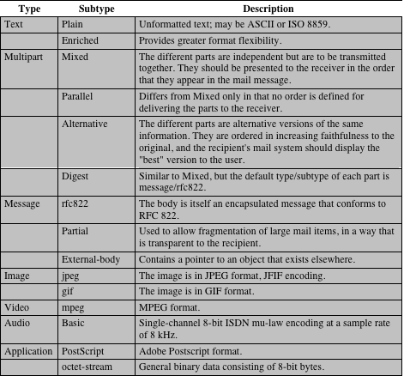
MIME Content Types
Notes:
The bulk of the MIME specification is concerned with the
definition of a variety of content types. This reflects the need to provide standardized
ways of dealing with a wide variety of information representations in a multimedia
environment.
Table 8.2 lists the content types specified in RFC 2046. There are seven different
major types of content and a total of 15 subtypes. In general, a content type
declares the general type of data, and the subtype specifies a particular format for
that type of data.
For the text type of body, no special software is required to get the full meaning
of the text aside from support of the indicated character set. The primary subtype
is plain text , which is simply a string of ASCII characters or ISO 8859 characters. The
enriched subtype allows greater formatting flexibility.
The multipart type indicates that the body contains multiple, independent
parts. The Content-Type header field includes a parameter (called a boundary) that
defines the delimiter between body parts. This boundary should not appear in any
parts of the message. Each boundary starts on a new line and consists of two hyphens
followed by the boundary value. The final boundary, which indicates the end
of the last part, also has a suffix of two hyphens. Within each part, there may be an
optional ordinary MIME header.
There are four subtypes of the multipart type, all of which have the same overall
syntax. The multipart/mixed subtype is used when there are multiple independent
body parts that need to be bundled in a particular order. For the multipart/
parallel subtype, the order of the parts is not significant. If the recipient’s system is
appropriate, the multiple parts can be presented in parallel. For example, a picture
or text part could be accompanied by a voice commentary that is played while the
picture or text is displayed.
For the multipart/alternative subtype, the various parts are different representations
of the same information.
The multipart/digest subtype is used when each of the body parts is interpreted
as an RFC 5322 message with headers. This subtype enables the construction
of a message whose parts are individual messages. For example, the moderator of a
group might collect e-mail messages from participants, bundle these messages, and
send them out in one encapsulating MIME message.
The message type provides a number of important capabilities in MIME.
The message/rfc822 subtype indicates that the body is an entire message, including
header and body. Despite the name of this subtype, the encapsulated message may
be not only a simple RFC 5322 message but also any MIME message.
The message/partial subtype enables fragmentation of a large message into a
number of parts, which must be reassembled at the destination. For this subtype,
three parameters are specified in the Content-Type: Message/Partial field: an id
common to all fragments of the same message, a sequence number unique to each
fragment, and the total number of fragments.
The message/external-body subtype indicates that the actual data to be conveyed
in this message are not contained in the body. Instead, the body contains the
information needed to access the data. As with the other message types, the message/
external-body subtype has an outer header and an encapsulated message with
its own header. The only necessary field in the outer header is the Content-Type
field, which identifies this as a message/external-body subtype. The inner header is
the message header for the encapsulated message. The Content-Type field in the
outer header must include an access-type parameter, which indicates the method of
access, such as FTP (file transfer protocol).
The application type refers to other kinds of data, typically either uninterpreted
binary data or information to be processed by a mail-based application.

Slide 15
S/MIME Functionality
S/MIME
Consists of encrypted content of any type and encrypted content encryption keys for one or more recipients
Signed data
A digital signature is formed by taking the message digest of the content to be signed and then encrypting that with the private key of the signer
The content plus signature are then encoded using base64 encoding
A signed data message can only be viewed by a recipient with S/MIME capability
Clear-signed data
Only the digital signature is encoded using base64
As a result recipients without S/MIME capability can view the message content, although they cannot verify the signature
Signed and enveloped data
Signed-only and encrypted-only entities may be nested, so that encrypted data may be signed and signed data or clear-signed data may be encrypted
Enveloped data
Notes:
In terms of general functionality, S/MIME is very similar to PGP. Both offer the
ability to sign and/or encrypt messages. In this subsection, we briefly summarize
S/MIME capability. We then look in more detail at this capability by examining
message formats and message preparation.
S/MIME provides the following functions.
• Enveloped data: This consists of encrypted content of any type and encrypted content
encryption keys for one or more recipients.
• Signed data: A digital signature is formed by taking the message digest of
the content to be signed and then encrypting that with the private key of
the signer. The content plus signature are then encoded using base64 encoding.
A signed data message can only be viewed by a recipient with S/MIME
capability.
• Clear-signed data: As with signed data, a digital signature of the content is
formed. However, in this case, only the digital signature is encoded using
base64. As a result, recipients without S/MIME capability can view the message
content, although they cannot verify the signature.
• Signed and enveloped data: Signed-only and encrypted-only entities may be
nested, so that encrypted data may be signed and signed data or clear-signed
data may be encrypted.

Slide 16
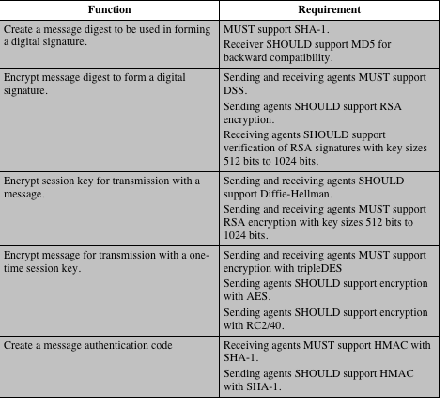
Cryptographic
Algorithms
Used in
S/MIME
Notes:
Table 8.5 summarizes the cryptographic algorithms
used in S/MIME. S/MIME uses the following terminology taken from RFC 2119
(Key Words for use in RFCs to Indicate Requirement Levels ) to specify the requirement
level:
• MUST: The definition is an absolute requirement of the specification. An implementation
must include this feature or function to be in conformance with
the specification.
• SHOULD: There may exist valid reasons in particular circumstances to ignore
this feature or function, but it is recommended that an implementation include
the feature or function.
S/MIME incorporates three public-key algorithms. The Digital Signature
Standard (DSS) described in Chapter 3 is the preferred algorithm for digital signature.
S/MIME lists Diffie-Hellman as the preferred algorithm for encrypting
session keys; in fact, S/MIME uses a variant of Diffie-Hellman that does provide
encryption/decryption, known as ElGamal (Chapter 10). As an alternative, RSA,
described in Chapter 3, can be used for both signatures and session key encryption.
These are the same algorithms used in PGP and provide a high level of security. For
the hash function used to create the digital signature, the specification requires the
160-bit SHA-1 but recommends receiver support for the 128-bit MD5 for backward
compatibility with older versions of S/MIME. As we discussed in Chapter 3, there
is justifiable concern about the security of MD5, so SHA-1 is clearly the preferred
alternative.
For message encryption, three-key triple DES (tripleDES) is recommended,
but compliant implementations must support 40-bit RC2. The latter is a weak encryption
algorithm but allows compliance with U.S. export controls.
The S/MIME specification includes a discussion of the procedure for deciding
which content encryption algorithm to use. In essence, a sending agent has two
decisions to make. First, the sending agent must determine if the receiving agent is
capable of decrypting using a given encryption algorithm. Second, if the receiving
agent is only capable of accepting weakly encrypted content, the sending agent must
decide if it is acceptable to send using weak encryption. To support this decision
process, a sending agent may announce its decrypting capabilities in order of preference
for any message that it sends out. A receiving agent may store that information
for future use.

Slide 17
S/MIME Certificate Processing
S/MIME uses public-key certificates that conform to version 3 of X.509
The key-management scheme used by S/MIME is in some ways a hybrid between a strict X.509 certification hierarchy and PGP’s web of trust
S/MIME managers and/or users must configure each client with a list of trusted keys and with certificate revocation lists
  The responsibility is local for maintaining the certificates needed to verify incoming signatures and to encrypt outgoing messages
The certificates are signed by certification authorities
Notes:
S/MIME uses public-key certificates that conform to version 3 of X.509 (see
Chapter 4). The key-management scheme used by S/MIME is in some ways a hybrid
between a strict X.509 certification hierarchy and PGP’s web of trust. As with
the PGP model, S/MIME managers and/or users must configure each client with a
list of trusted keys and with certificate revocation lists. That is, the responsibility is
local for maintaining the certificates needed to verify incoming signatures and to
encrypt outgoing messages. On the other hand, the certificates are signed by certification
authorities.

Slide 18
User Agent Role
Key generation
The user of some related administrative utility must be capable of generating separate Diffie-Hellman and DSS key pairs and should be capable of generating RSA key pairs
A user agent should generate RSA key pairs with a length in the range of 768 to 1024 bits and must not generate a length of less than 512 bits
Registration
A user’s public key must be registered with a certification authority in order to receive an X.509 public-key certificate
Certificate storage and retrieval
A user requires access to a local list of certificates in order to verify incoming signatures and to encrypt outgoing messages
An S/MIME user has several key-management functions to perform:
Notes:
An S/MIME user has several key-management functions to
perform.
• Key generation: The user of some related administrative utility (e.g., one associated
with LAN management) MUST be capable of generating separate
Diffie-Hellman and DSS key pairs and SHOULD be capable of generating
RSA key pairs. Each key pair MUST be generated from a good source of
nondeterministic random input and be protected in a secure fashion. A user
agent SHOULD generate RSA key pairs with a length in the range of 768 to
1024 bits and MUST NOT generate a length of less than 512 bits.
• Registration: A user’s public key must be registered with a certification authority
in order to receive an X.509 public-key certificate.
• Certificate storage and retrieval: A user requires access to a local list of certificates
in order to verify incoming signatures and to encrypt outgoing messages.
Such a list could be maintained by the user or by some local administrative
entity on behalf of a number of users.

Slide 19
VeriSign Certificates
VeriSign provides a certification authority (CA) service that is intended to be compatible with S/MIME and a variety of other applications
Issues X.509 certificates with the product name VeriSign Digital ID
At a minimum, each Digital ID contains:
  Owner’s public key
  Owner’s name or alias
  Expiration date of the Digital ID
  Serial number of the Digital ID
  Name of the certification authority that issued the Digital ID
  Digital signature of the certification authority that issued the Digital ID
  Address
  E-Mail Address
  Basic Registration information (country, zipcode,age and
  gender)
Notes:
There are several companies that provide certification authority
(CA) services. For example, Nortel has designed an enterprise CA solution
and can provide S/MIME support within an organization. There are a number
of Internet-based CAs, including VeriSign, GTE, and the U.S. Postal Service. Of
these, the most widely used is the VeriSign CA service, a brief description of which
we now provide.
VeriSign provides a CA service that is intended to be compatible with
S/MIME and a variety of other applications. VeriSign issues X.509 certificates
with the product name VeriSign Digital ID. As of early 1998, over 35,000 commercial
Web sites were using VeriSign Server Digital IDs, and over a million
consumer Digital IDs had been issued to users of Netscape and Microsoft
browsers.
The information contained in a Digital ID depends on the type of Digital ID
and its use. At a minimum, each Digital ID contains
• Owner’s public key
• Owner’s name or alias
• Expiration date of the Digital ID
• Serial number of the Digital ID
• Name of the certification authority that issued the Digital ID
• Digital signature of the certification authority that issued the Digital ID
Digital IDs can also contain other user-supplied information, including
• Address
• E-mail address
• Basic registration information (country, zip code, age, and gender)

Slide 20
Summary
Pretty good privacy
  Notation
  Operational description
S/MIME
  RFC 5322
  Multipurpose Internet mail extensions
  S/MIME functionality
  S/MIME messages
  S/MIME certification processing
  Enhanced security services
Notes:
Chapter 8 summary.

